Slide 1
Открытый урок английского языка в 9А классе
по теме «Как пройти…?»
Spotlight – 9 Module 6b
Подготовила:
Куулар Алдын-кыс Болатовна
МБОУ «Хову-Аксынская СОШ»

Slide 2
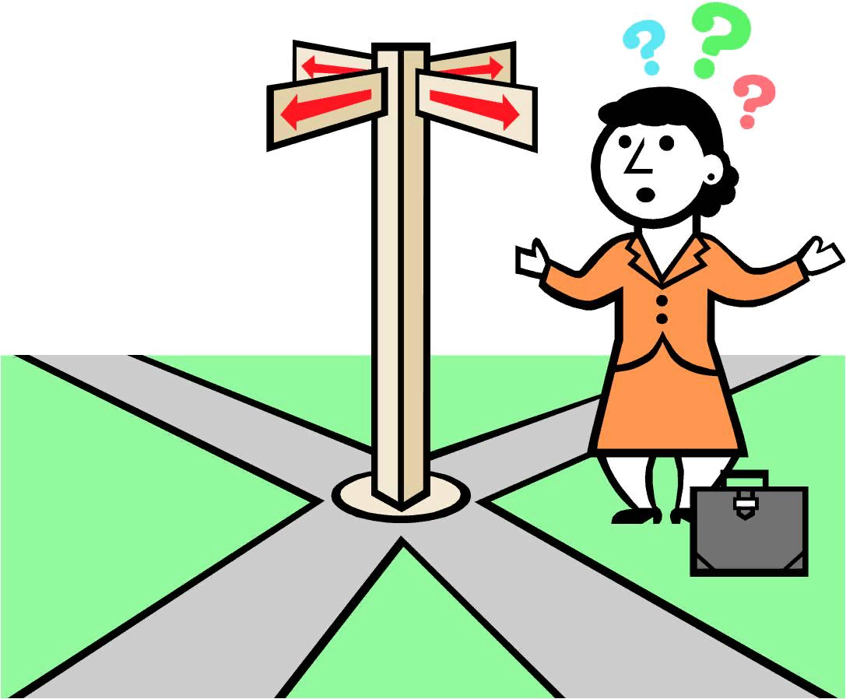
Do you remember a situation when you lost your way?

Slide 3
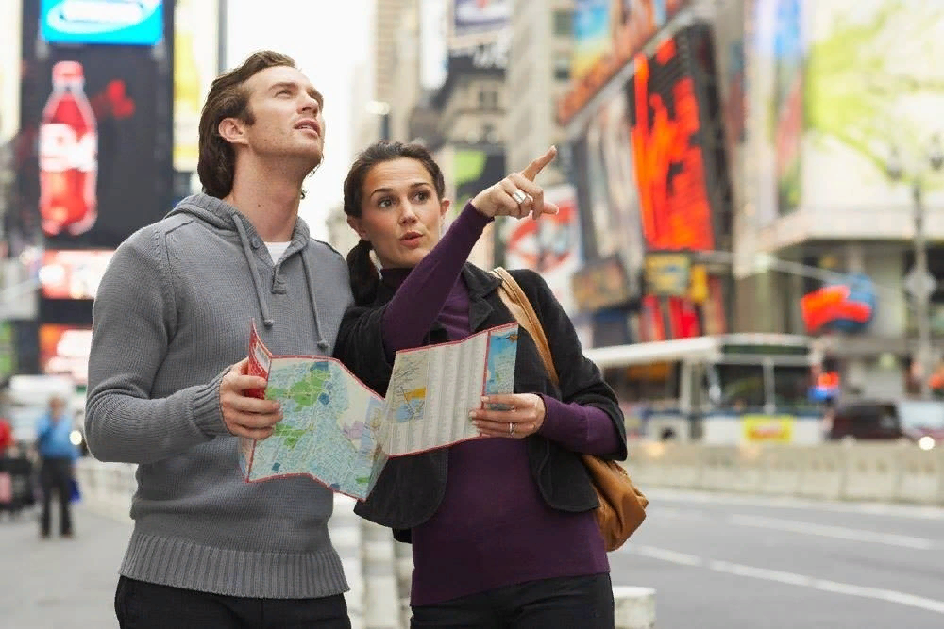
What did you do in that situation?

Slide 4
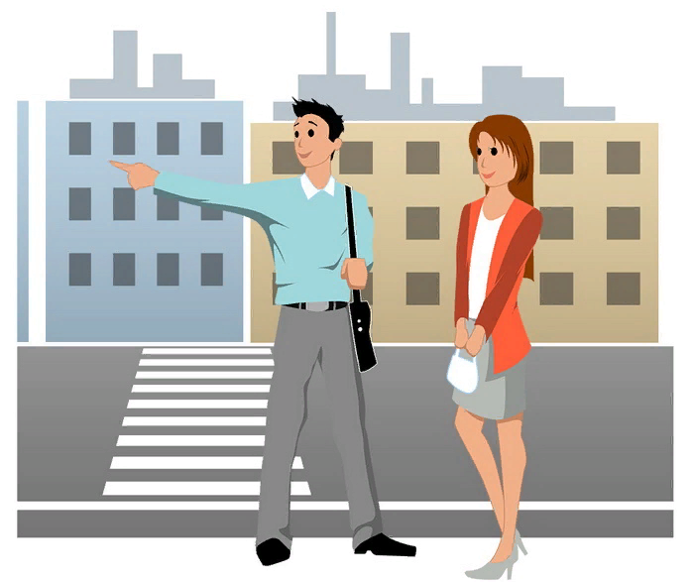
Guess what the topic of our lesson is!

Slide 5
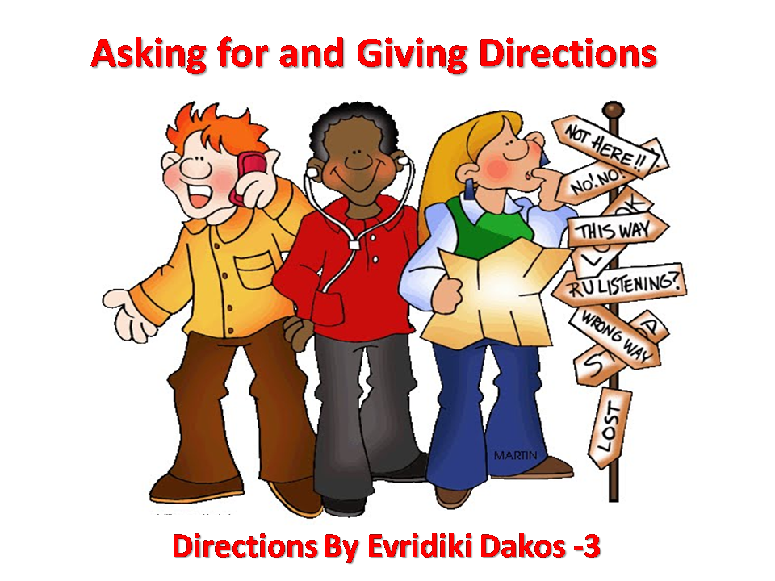
The 15th
of February
Asking directions

Slide 6
“Asking for and giving directions”
At the lesson
we will repeat the words
learn new words
listen to the dialogues and work with them.

Slide 7
“Asking directions”
Have you ever helped anyone in your hometown?
What places in the city can you call?

Slide 8
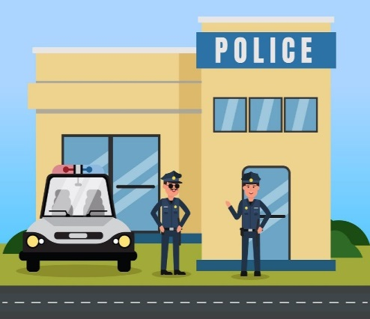
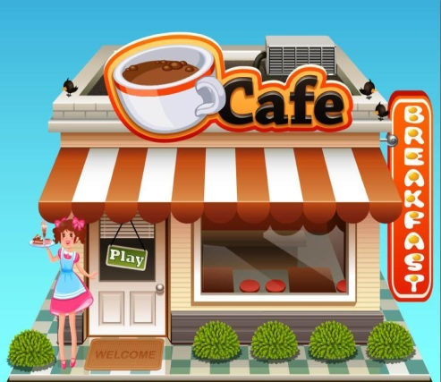

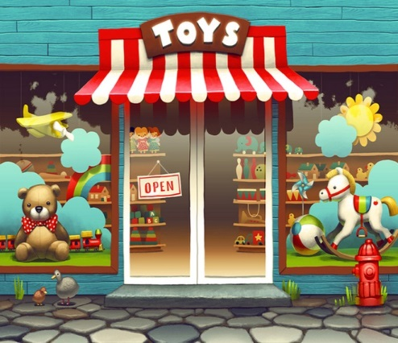
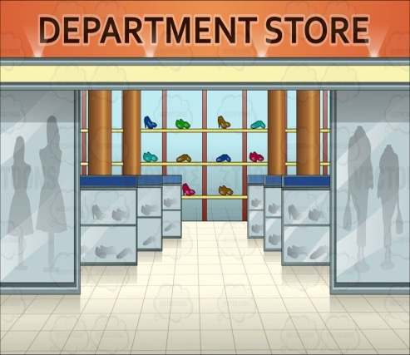
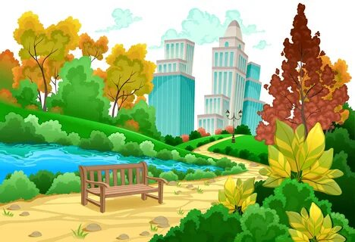






Police station
Café
Toy Shop
Park
Library
Post Office

Slide 9
https://quizlet.com/ru/369008130/spotlight-9-module-6b-flash-cards/

Slide 10
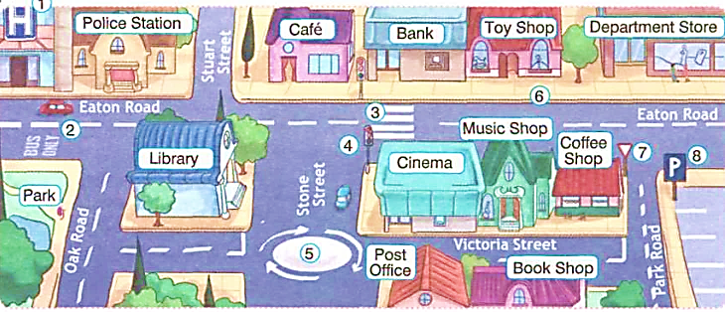
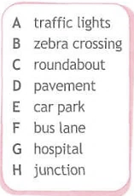
A 4
B 3
C 5
D 6
E 8
F 2
G 1
H 7

Slide 11
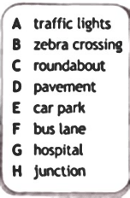
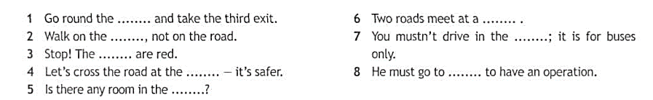
Fill in the words in the sentences below.

Slide 12
Go round the roundabout and take the third exit.
Walk on the pavement, not on the road.
Stop! The traffic lights are red.
Let’s cross the road at the zebra crossing - it’s safer.
Is there any room in the car park?
Two roads meet at a junction.
You mustn’t drive in the bus lane; it’s for buses only.
He must go to hospital to have an operation.

Slide 13






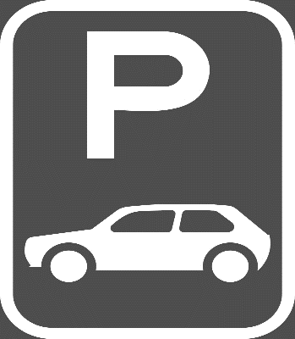







Slide 14







services
sightseeing
transport

Slide 15
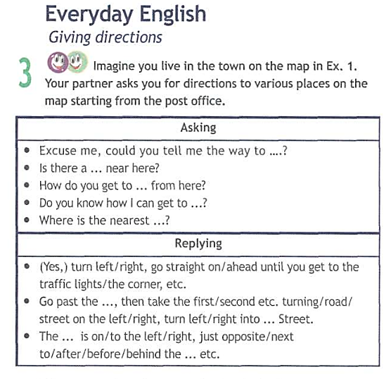
Excuse me, could you tell me the way to the hospital?
Is there a car park near here?
How do you get to the Art museum from here?
Do you know how I can get to nearest café?
Where is the nearest bus stop?

Slide 16
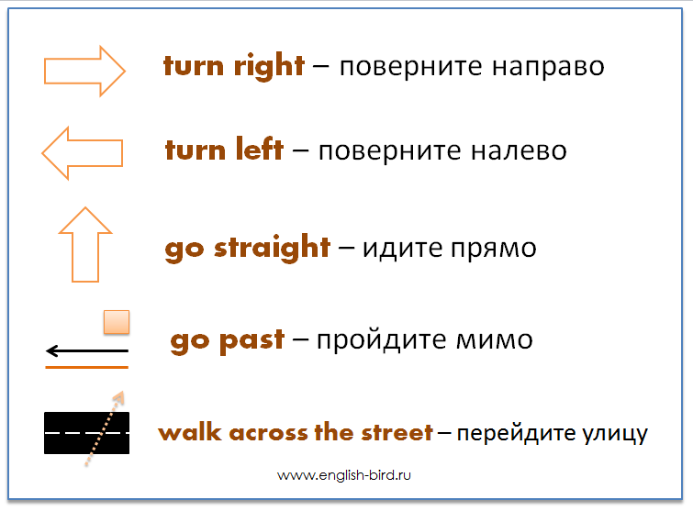

Slide 17
Go straight ahead – идите прямо вперед
Go past – идите мимо
Take the first turning on the right into Apple Street – поверните в первый поворот направо
Opposite - напротив
Next to - рядом
After - после
Behind - позади
Before - перед

Slide 18
Go straight ahead –
Go past –
Take the first turning on the right into Apple Street –
Opposite –
Next to –
After –
Behind –
Before -

Slide 19
Turn left, go straight ahead until you get to the traffic lights.
Go past the bookshop, then take the second turning on the right into Apple Street.
The hospital is on the left, just opposite the shop.

Slide 20
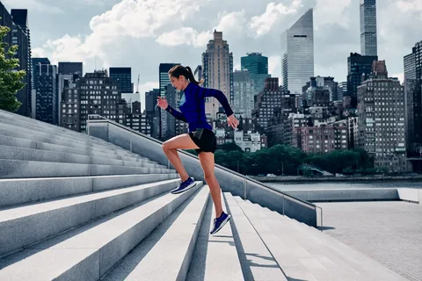
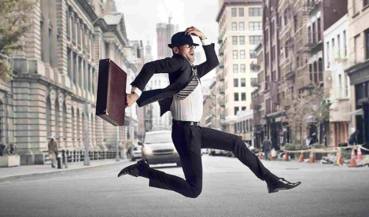
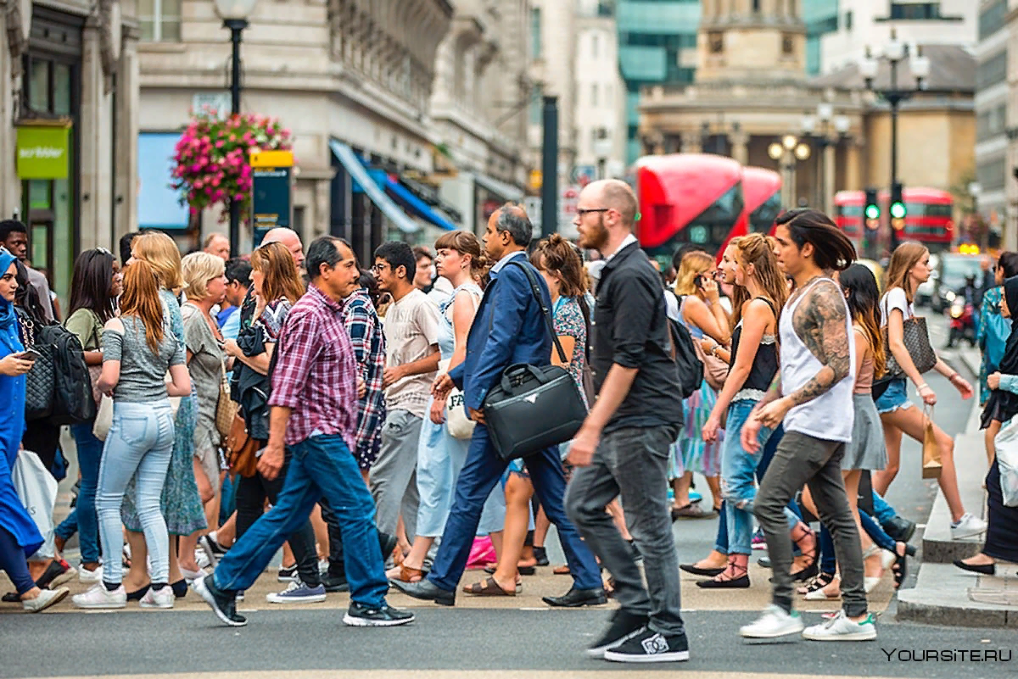


Slide 21
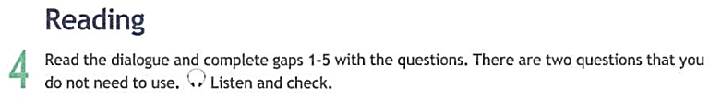

Slide 22
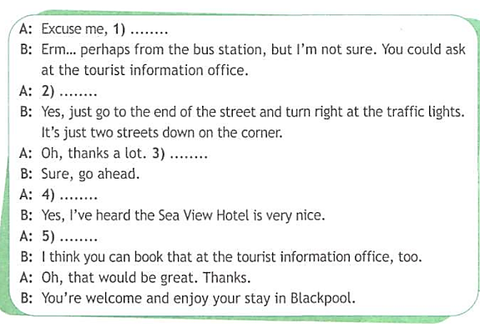
E
Do you know where I can get a bus to Blackpool Tower?
B
Is it nearby?
A
Do you mind if I ask something else?
F
Can you recommend a good hotel?
D
How can I book a room?

Slide 23
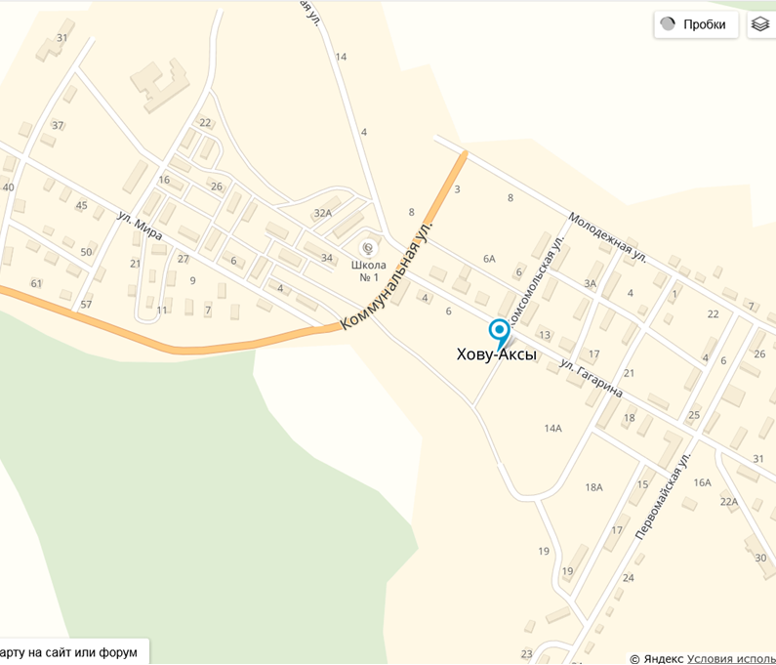

Slide 24
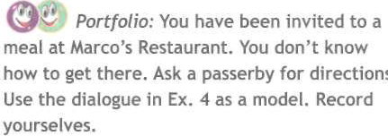
Homework
p. 93 ex. 9

Slide 25
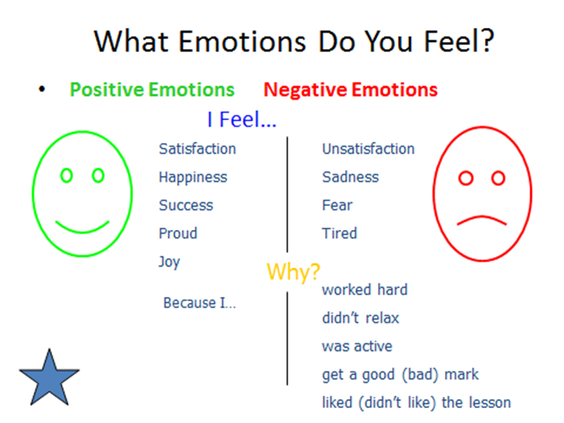

Slide 26


THANK YOU FOR THE LESSON!
GOOD BYE!

